Slide 1
2
Introduction to C++ Programming

Slide 2
What’s in a name? that which we call a rose By any other name would smell as sweet.
  William Shakespeare
When faced with a decision, I always ask, “What would be the most fun?”
  Peggy Walker

Slide 3
“Take some more tea,” the March Hare said to Alice, very earnestly. “I’ve had nothing yet, “Alice replied in an offended tone: “so I can’t take more.” “You mean you can’t take less,” said the Hatter: “it’s very easy to take more than nothing.”
  Lewis Carroll
High thoughts must have high language.
  Aristophanes

Slide 4
OBJECTIVES
In this chapter you will learn:
To write simple computer programs in C++.
To write simple input and output statements.
To use fundamental types.
Basic computer memory concepts.
To use arithmetic operators.
The precedence of arithmetic operators.
To write simple decision-making statements.

Slide 5
2.1 Introduction
2.2 First Program in C++: Printing a Line of Text
2.3 Modifying Our First C++ Program
2.4 Another C++ Program: Adding Integers
2.5 Memory Concepts
2.6 Arithmetic
2.7 Decision Making: Equality and Relational Operators
2.8 (Optional) Software Engineering Case Study: Examining the ATM Requirements Document
2.9 Wrap-Up

Slide 6
2.1 Introduction
C++ programming
  Facilitates disciplined approach to computer program design
  Programs process information and display results
Five examples demonstrate
  How to display messages
  How to obtain information from the user
  How to perform arithmetic calculations
  How to make decisions

Slide 7
2.2 First Program in C++: Printing a Line of Text
Simple program
  Prints a line of text
  Illustrates several important features of C++

Slide 8
2.2 First Program in C++: Printing a Line of Text (Cont.)
Comments
  Explain programs to other programmers
    Improve program readability
  Ignored by compiler
  Single-line comment
    Begin with //
    Example
      // This is a text-printing program.
  Multi-line comment
    Start with /*
    End with */

Slide 9
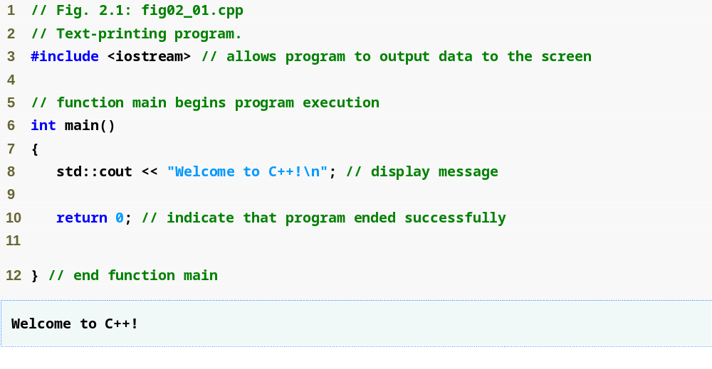
Outline
Single-line comments
Function main returns an integer value
Preprocessor directive to include input/output stream header file <iostream>
Left brace { begins function body
Function main appears exactly once in every C++ program
Statements end with a semicolon ;
fig02_01.cpp
(1 of 1)
fig02_01.cpp
output (1 of 1)
Corresponding right brace } ends function body
Stream insertion operator
Name cout belongs to namespace std
Keyword return is one of several means to exit a function; value 0 indicates that the program terminated successfully

Slide 10
Good Programming Practice 2.1
Every program should begin with a comment that describes the purpose of the program, author, date and time. (We are not showing the author, date and time in this book’s programs because this information would be redundant.)

Slide 11
2.2 First Program in C++: Printing a Line of Text (Cont.)
Preprocessor directives
  Processed by preprocessor before compiling
  Begin with #
  Example
    #include <iostream>
      Tells preprocessor to include the input/output stream header file <iostream>
White space
  Blank lines, space characters and tabs
  Used to make programs easier to read
  Ignored by the compiler

Slide 12
Common Programming Error 2.1
Forgetting to include the <iostream> header file in a program that inputs data from the key­board or outputs data to the screen causes the compiler to issue an error message, because the compiler cannot recognize references to the stream components (e.g., cout).

Slide 13
Good Programming Practice 2.2
Use blank lines and space characters to enhance program readability.

Slide 14
2.2 First Program in C++: Printing a Line of Text (Cont.)
Function main
  A part of every C++ program
    Exactly one function in a program must be main
  Can “return” a value
  Example
    int main()
      This main function returns an integer (whole number)
  Body is delimited by braces ({})
Statements
  Instruct the program to perform an action
  All statements end with a semicolon (;)

Slide 15
2.2 First Program in C++: Printing a Line of Text (Cont.)
Namespace
  std::
    Specifies using a name that belongs to “namespace” std
    Can be removed through use of using statements
Standard output stream object
  std::cout
    “Connected” to screen
    Defined in input/output stream header file <iostream>

Slide 16
2.2 First Program in C++: Printing a Line of Text (Cont.)
Stream insertion operator <<
  Value to right (right operand) inserted into left operand
  Example
    std::cout << "Hello";
      Inserts the string "Hello" into the standard output
        Displays to the screen
Escape characters
  A character preceded by "\"
    Indicates “special” character output
  Example
    "\n"
      Cursor moves to beginning of next line on the screen

Slide 17
Common Programming Error 2.2
Omitting the semicolon at the end of a C++ statement is a syntax error. (Again, preprocessor directives do not end in a semicolon.) The syntax of a programming language specifies the rules for creating a proper program in that language. A syntax error occurs when the compiler encounters code that violates C++’s language rules (i.e., its syntax). The compiler normally issues an error message to help the programmer locate and fix the incorrect code. (cont…)

Slide 18
2.2 First Program in C++: Printing a Line of Text (Cont.)
return statement
  One of several means to exit a function
  When used at the end of main
    The value 0 indicates the program terminated successfully
    Example
      return 0;

Slide 19
Good Programming Practice 2.3
Many programmers make the last character printed by a function a newline (\n). This ensures that the function will leave the screen cursor positioned at the beginning of a new line. Conventions of this nature encourage software reusability—a key goal in software development.

Slide 20
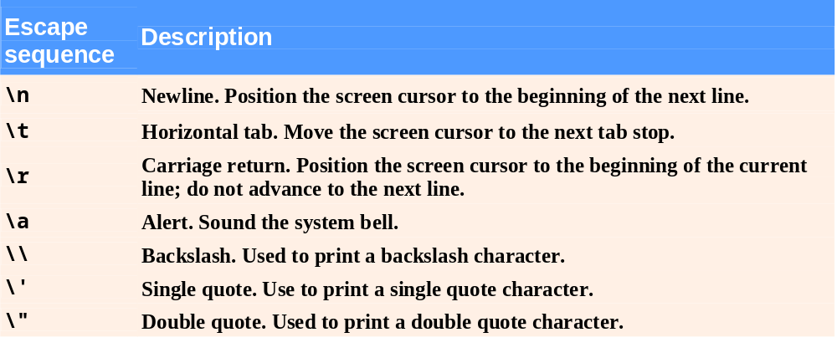
Fig. 2.2 | Escape sequences.

Slide 21
Good Programming Practice 2.4
Indent the entire body of each function one level within the braces that delimit the body of the function. This makes a program’s functional structure stand out and helps make the program easier to read.

Slide 22
Good Programming Practice 2.5
Set a convention for the size of indent you prefer, then apply it uniformly. The tab key may be used to create indents, but tab stops may vary. We recommend using either 1/4-inch tab stops or (preferably) three spaces to form a level of indent.

Slide 23
2.3 Modifying Our First C++ Program
Two examples
  Print text on one line using multiple statements (Fig. 2.3)
    Each stream insertion resumes printing where the previous one stopped
  Print text on several lines using a single statement (Fig. 2.4)
    Each newline escape sequence positions the cursor to the beginning of the next line
    Two newline characters back to back outputs a blank line

Slide 24
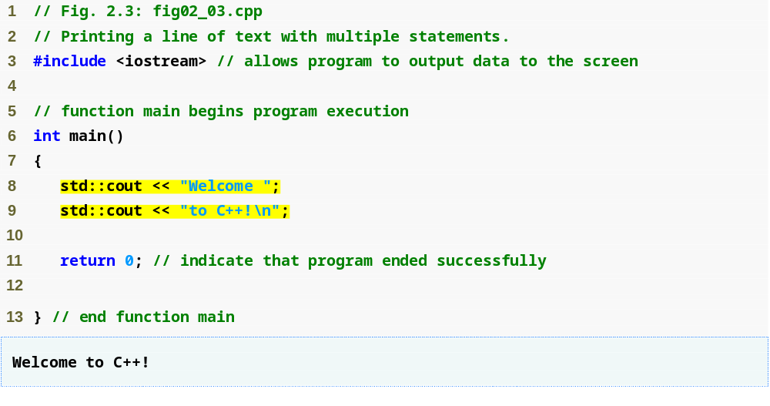
Outline
Multiple stream insertion statements produce one line of output
fig02_03.cpp
(1 of 1)
fig02_03.cpp output (1 of 1)

Slide 25
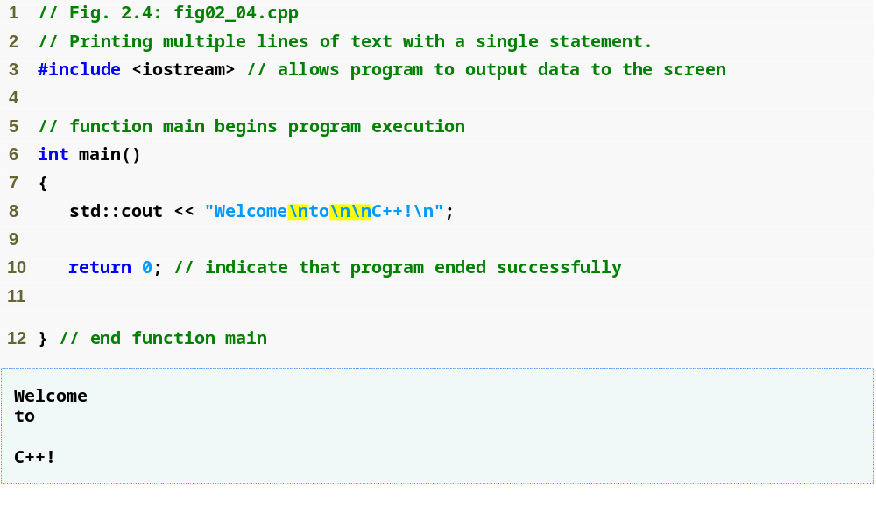
Outline
Use newline characters to print on multiple lines
fig02_04.cpp
(1 of 1)
fig02_04.cpp output (1 of 1)

Slide 26
2.4 Another C++ Program: Adding Integers
Variables
  Location in memory where value can be stored
  Common data types (fundamental, primitive or built-in)
    int – integer numbers
    char – characters
    double – floating point numbers
  Declare variables with name and data type before use
    int integer1;
    int integer2;
    int sum;

Slide 27
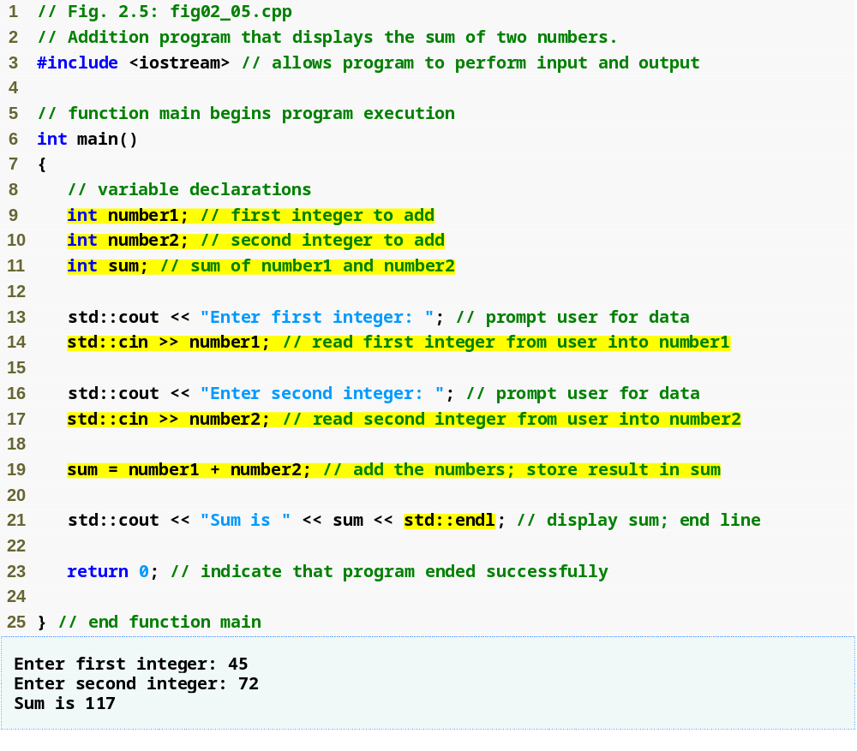
Outline
fig02_05.cpp
(1 of 1)
fig02_05.cpp output (1 of 1)
Declare integer variables
Use stream extraction operator with standard input stream to obtain user input
Stream manipulator std::endl outputs a newline, then “flushes output buffer”
Concatenating, chaining or cascading stream insertion operations

Slide 28
2.4 Another C++ Program: Adding Integers (Cont.)
Variables (Cont.)
  Can declare several variables of same type in one declaration
    Comma-separated list
    int integer1, integer2, sum;
  Variable names
    Valid identifier
      Series of characters (letters, digits, underscores)
      Cannot begin with digit
      Case sensitive

Slide 29
Good Programming Practice 2.10
Avoid identifiers that begin with underscores and double underscores, because C++ compilers may use names like that for their own purposes internally. This will prevent names you choose from being confused with names the compilers choose.

Slide 30
Error-Prevention Tip 2.1
Languages like C++ are “moving targets.” As they evolve, more keywords could be added to the language. Avoid using “loaded” words like “object” as identifiers. Even though “object” is not currently a keyword in C++, it could become one; therefore, future compiling with new compilers could break existing code.

Slide 31
2.4 Another C++ Program: Adding Integers (Cont.)
Input stream object
  std::cin from <iostream>
    Usually connected to keyboard
    Stream extraction operator >>
      Waits for user to input value, press Enter (Return) key
      Stores value in variable to right of operator
        Converts value to variable data type
    Example
      std::cin >> number1;
        Reads an integer typed at the keyboard
        Stores the integer in variable number1

Slide 32
Error-Prevention Tip 2.2
Programs should validate the correctness of all input values to prevent erroneous information from affecting a program’s calculations.

Slide 33
2.4 Another C++ Program: Adding Integers (Cont.)
Assignment operator =
  Assigns value on left to variable on right
  Binary operator (two operands)
  Example:
    sum = variable1 + variable2;
      Add the values of variable1 and variable2
      Store result in sum
Stream manipulator std::endl
  Outputs a newline
  Flushes the output buffer

Slide 34
2.4 Another C++ Program: Adding Integers (Cont.)
Concatenating stream insertion operations
  Use multiple stream insertion operators in a single statement
    Stream insertion operation knows how to output each type of data
  Also called chaining or cascading
  Example
    std::cout << "Sum is " << number1 + number2
    << std::endl;
      Outputs "Sum is “
      Then, outputs sum of number1 and number2
      Then, outputs newline and flushes output buffer

Slide 35
2.5 Memory Concept
Variable names
  Correspond to actual locations in computer's memory
    Every variable has name, type, size and value
  When new value placed into variable, overwrites old value
    Writing to memory is destructive
  Reading variables from memory nondestructive
  Example
    sum = number1 + number2;
      Value of sum is overwritten
      Values of number1 and number2 remain intact

Slide 36
Fig. 2.6 | Memory location showing the name and value of variable number1.

Slide 37

Fig. 2.7 | Memory locations after storing values for number1 and number2.

Slide 38

Fig. 2.8 | Memory locations after calculating and storing the sum of number1 and number2.

Slide 39
2.6 Arithmetic
Arithmetic operators
  *
    Multiplication
  /
    Division
    Integer division truncates remainder
      7 / 5 evaluates to 1
  %
    Modulus operator returns remainder
      7 % 5 evaluates to 2

Slide 40
Common Programming Error 2.3
Attempting to use the modulus operator (%) with noninteger operands is a compilation error.

Slide 41
2.6 Arithmetic (Cont.)
Straight-line form
  Required for arithmetic expressions in C++
  All constants, variables and operators appear in a straight line
Grouping subexpressions
  Parentheses are used in C++ expressions to group subexpressions
    Same manner as in algebraic expressions
  Example
    a * ( b + c )
      Multiple a times the quantity b + c

Slide 42
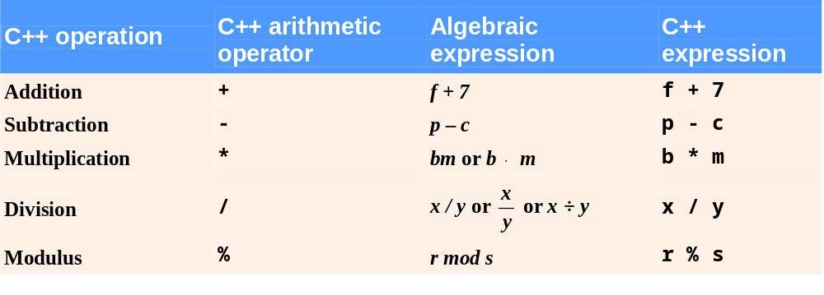
Fig. 2.9 | Arithmetic operators.

Slide 43
2.6 Arithmetic (Cont.)
Rules of operator precedence
  Operators in parentheses evaluated first
    Nested/embedded parentheses
      Operators in innermost pair first
  Multiplication, division, modulus applied next
    Operators applied from left to right
  Addition, subtraction applied last
    Operators applied from left to right

Slide 44
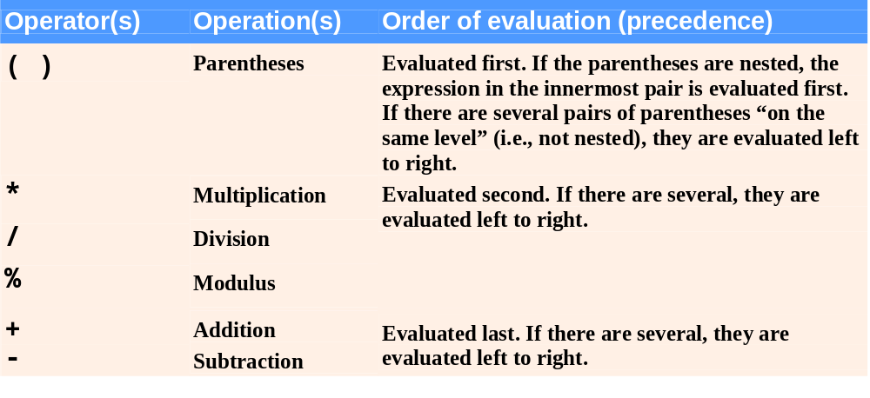
Fig. 2.10 | Precedence of arithmetic operators.

Slide 45
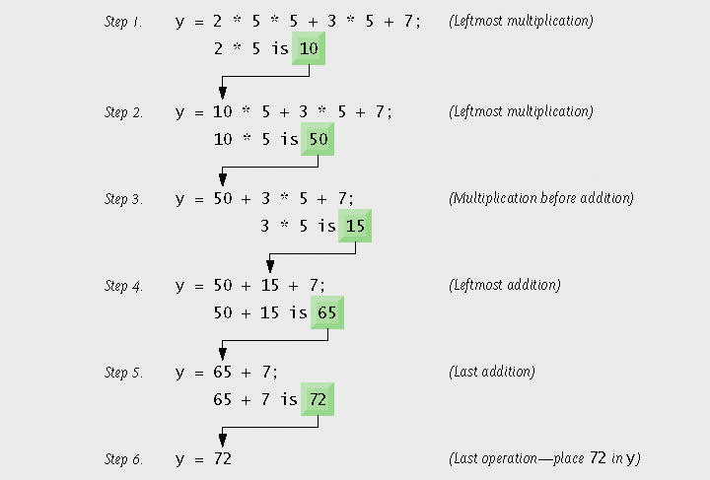
Fig. 2.11 | Order in which a second-degree polynomial is evaluated.

Slide 46
2.7 Decision Making: Equality and Relational Operators
Condition
  Expression can be either true or false
  Can be formed using equality or relational operators
if statement
  If condition is true, body of the if statement executes
  If condition is false, body of the if statement does not execute

Slide 47
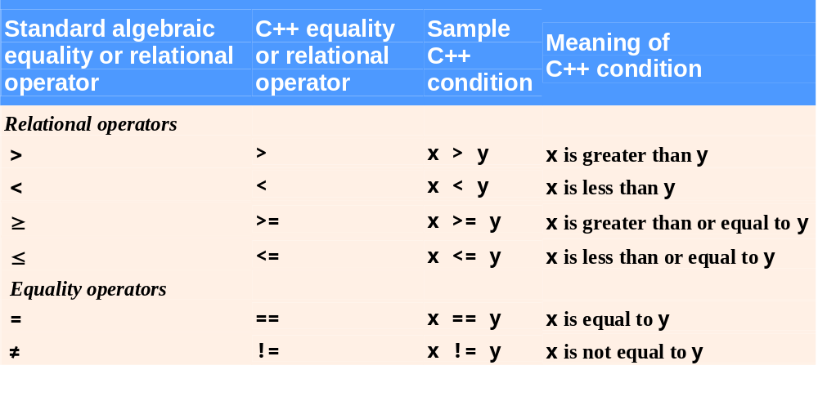
Fig. 2.12 | Equality and relational operators.

Slide 48
Common Programming Error 2.5
A syntax error will occur if any of the operators ==, !=, >= and <= appears with spaces between its pair of symbols.

Slide 49
Common Programming Error 2.6
Reversing the order of the pair of symbols in any of the operators !=, >= and <= (by writing them as =!, => and =<, respectively) is normally a syntax error. In some cases, writing != as =! will not be a syntax error, but almost certainly will be a logic error that has an effect at execution time. (cont…)

Slide 50
Common Programming Error 2.6
You will understand why when you learn about logical operators in Chapter 5. A fatal logic error causes a program to fail and terminate prematurely. A nonfatal logic error allows a program to continue executing, but usually produces incorrect results.

Slide 51
Common Programming Error 2.7
Confusing the equality operator == with the assignment operator = results in logic errors. The equality operator should be read “is equal to,” and the assignment operator should be read “gets” or “gets the value of” or “is assigned the value of.” Some people prefer to read the equality operator as “double equals.” As we discuss in Section 5.9, confusing these operators may not necessarily cause an easy-to-recognize syntax error, but may cause extremely subtle logic errors.

Slide 52
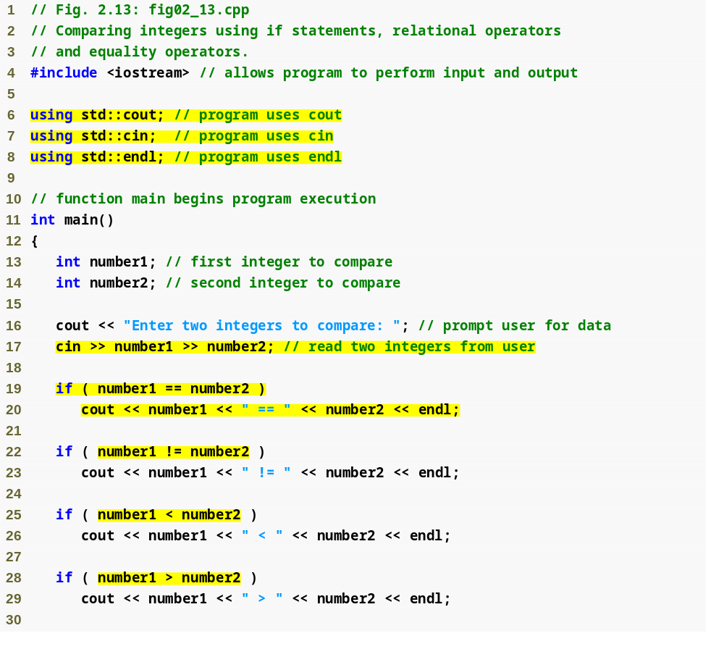
Outline
fig02_13.cpp
(1 of 2)
using declarations eliminate need for std:: prefix
Declare variables
Can write cout and cin without std:: prefix
if statement compares values of number1 and number2 to test for equality
If condition is true (i.e., values are equal), execute this statement
if statement compares values of number1 and number2 to test for inequality
If condition is true (i.e., values are not equal), execute this statement
Compares two numbers using relational operator < and >

Slide 53
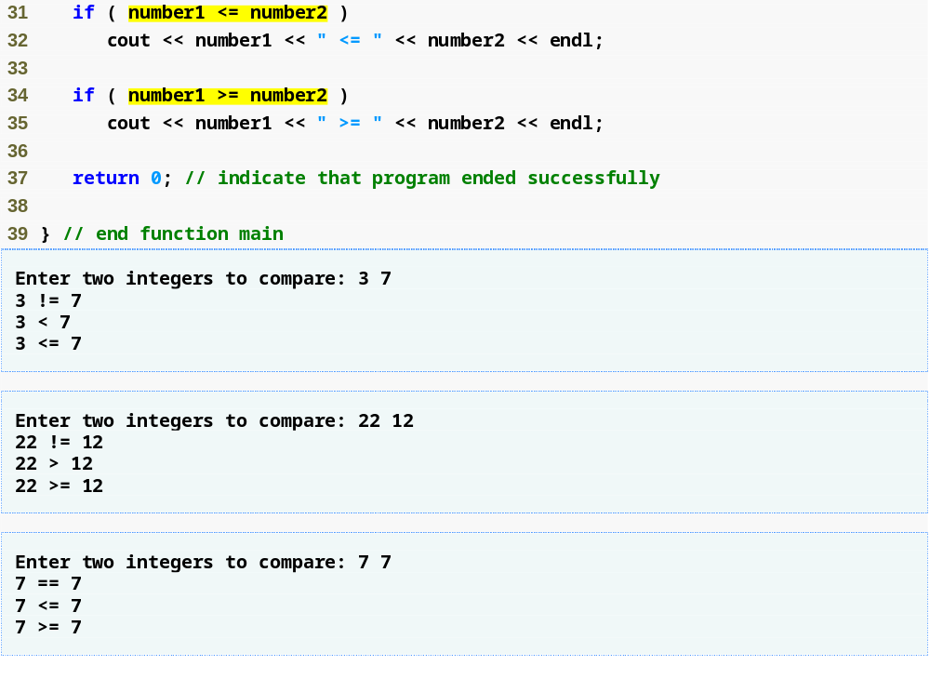
Outline
Compares two numbers using relational operators <= and >=
fig02_13.cpp
(2 of 2)
fig02_13.cpp output (1 of 3)
(2 of 3)
(3 of 3)

Slide 54
Good Programming Practice 2.15
Place using declarations immediately after the #include to which they refer.

Slide 55
Good Programming Practice 2.16
Indent the statement(s) in the body of an if statement to enhance readability.

Slide 56
Good Programming Practice 2.17
For readability, there should be no more than one statement per line in a program.

Slide 57
Common Programming Error 2.8
Placing a semicolon immediately after the right parenthesis after the condition in an if statement is often a logic error (although not a syntax error). The semicolon causes the body of the if statement to be empty, so the if statement performs no action, regardless of whether or not its condition is true. Worse yet, the original body statement of the if statement now would become a statement in sequence with the if statement and would always execute, often causing the program to produce incorrect results.

Slide 58
Common Programming Error 2.9
It is a syntax error to split an identifier by inserting white-space characters (e.g., writing main as ma in).

Slide 59
Good Programming Practice 2.18
A lengthy statement may be spread over several lines. If a single statement must be split across lines, choose meaningful breaking points, such as after a comma in a comma-separated list, or after an operator in a lengthy expression. If a statement is split across two or more lines, indent all subsequent lines and left-align the group.

Slide 60
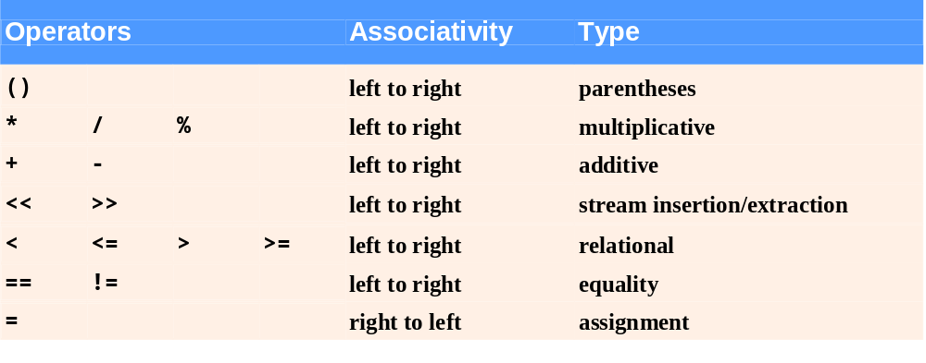
Fig. 2.14 | Precedence and associativity of the operators discussed so far.

Slide 61
Good Programming Practice 2.19
Refer to the operator precedence and associativity chart when writing expressions containing many opera­tors. Confirm that the operators in the expression are performed in the order you expect. If you are uncertain about the order of evaluation in a complex expression, break the expression into smaller statements or use parentheses to force the order of evaluation, exactly as you would do in an algebraic expression. Be sure to ob­serve that some operators such as assignment (=) associate right to left rather than left to right.

